Slide 1

CSE3151
Computer Networks
(Session 2018-19)
Dr. Asif Zaman
Associate Professor, CSE, RU
May 2022

Slide 2
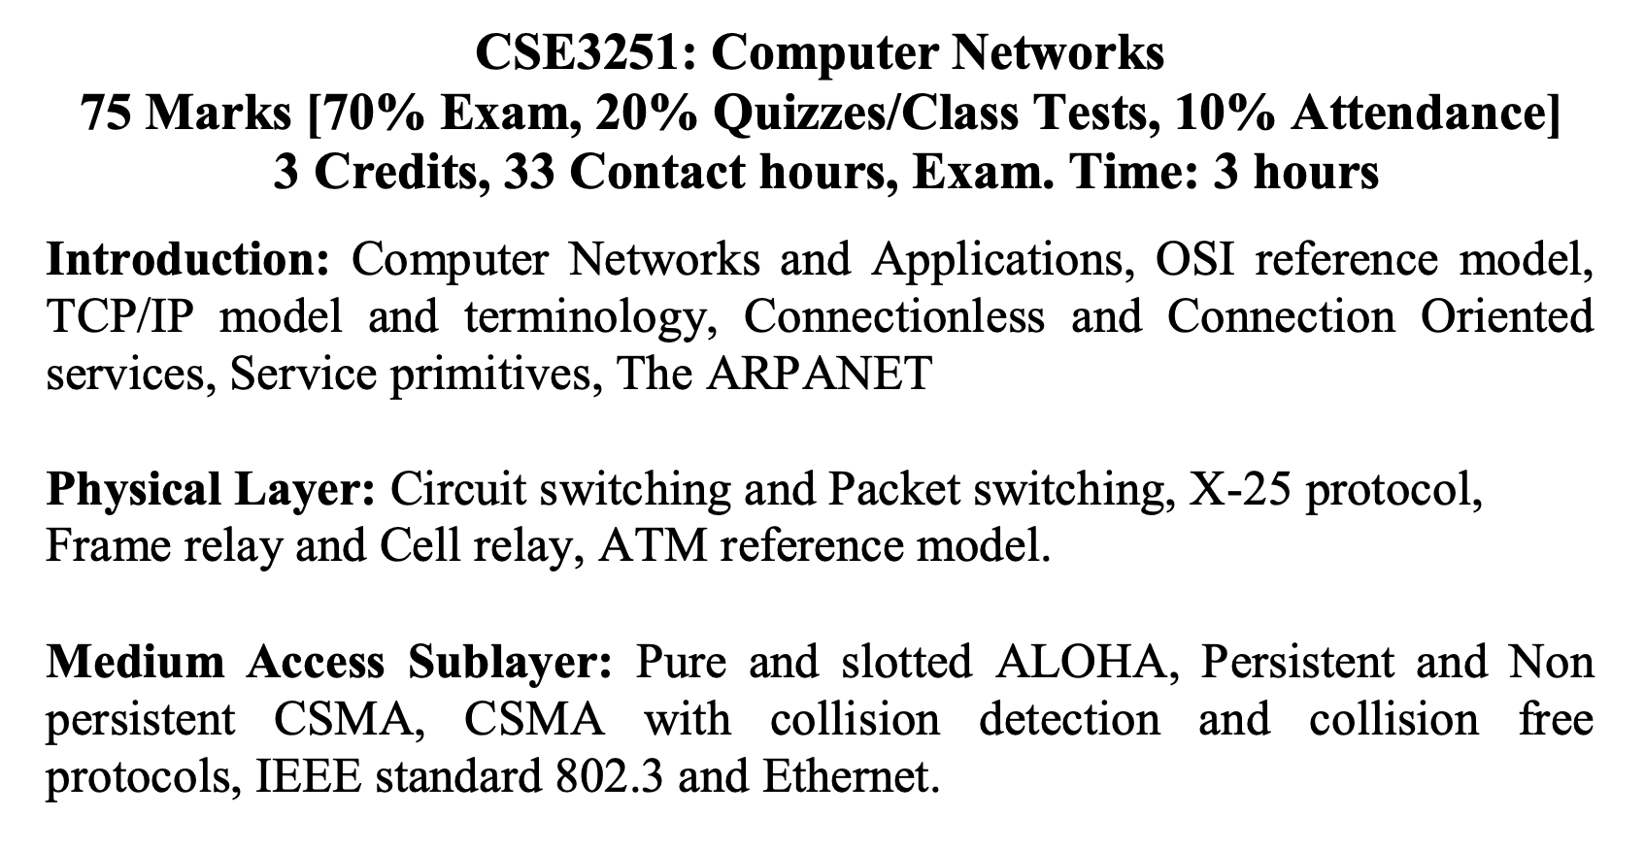
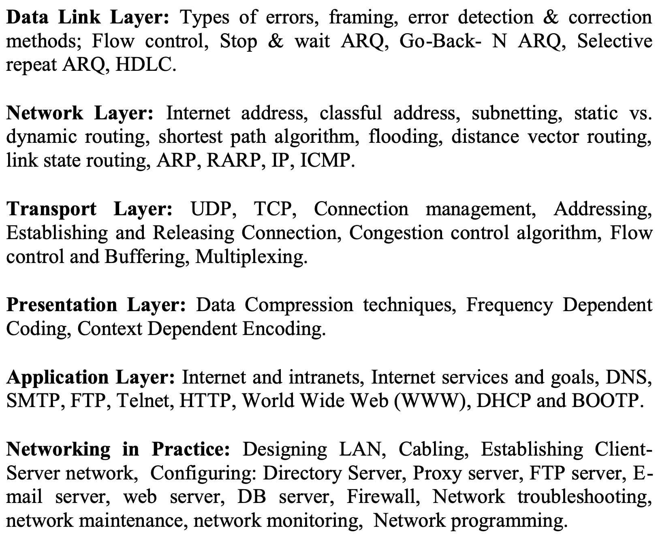

Slide 3
Computer Network?
Collection of autonomous computers interconnected by a single technology.
Two computers are said to be interconnected if they are able to exchange information.
The connection need not be via a copper wire; fiber optics, microwaves, infrared, and communication satellites can also be used.

Slide 4
Computer Network vs Distributed System
There is considerable confusion in the literature between a computer network and a distributed system.
Distributed system… appear as a single system to user.
A distributed system is a software system built on top of a network.

Slide 5
Uses of Computer Network
Application of Computer Network
Business Applications
Home Applications
Mobile Users
Social Issues

Slide 6
Business Applications
Primary Goal???
Resource sharing:
The goal is to make all programs, equipment, and especially data available to anyone on the network without regard to the physical location of the resource or the user
Share printer
more important than sharing physical resources –sharing data
Share customer records…
VPNs (Virtual Private Networks)
Client Server Model:
Web application

Slide 7
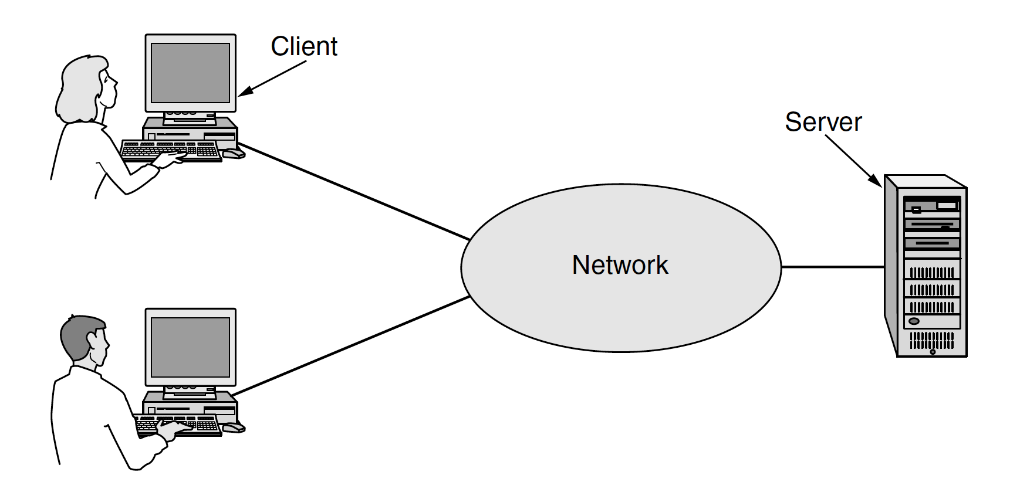
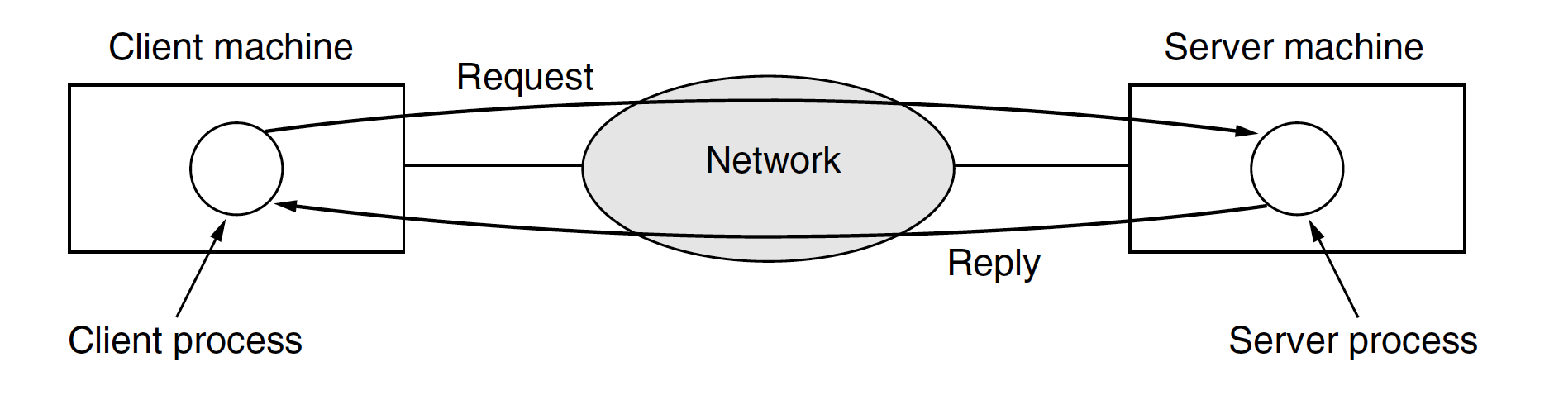
Business Applications

Slide 8
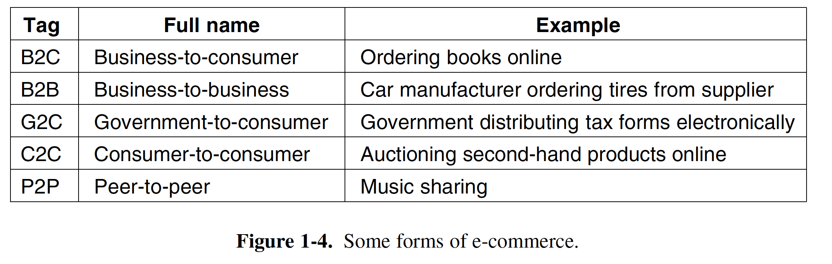
Business Application
Secondary Goal
Powerful communication medium:
Email, VOIP, video calling
Desktop sharing
TeamViewer,
Tertiary Goal
e-commerce (electronic commerce)

Slide 9
Home Application
Connectivity
to remote computers
home users can access information, communicate with other people, and buy products and services with e-commerce.
People can surf the net for fun, movie, chatting…
People can surf the net for news portals
People can surf the net for research like IEEE, Springers…
Mainly Client server model but… peer to peer model

Slide 10
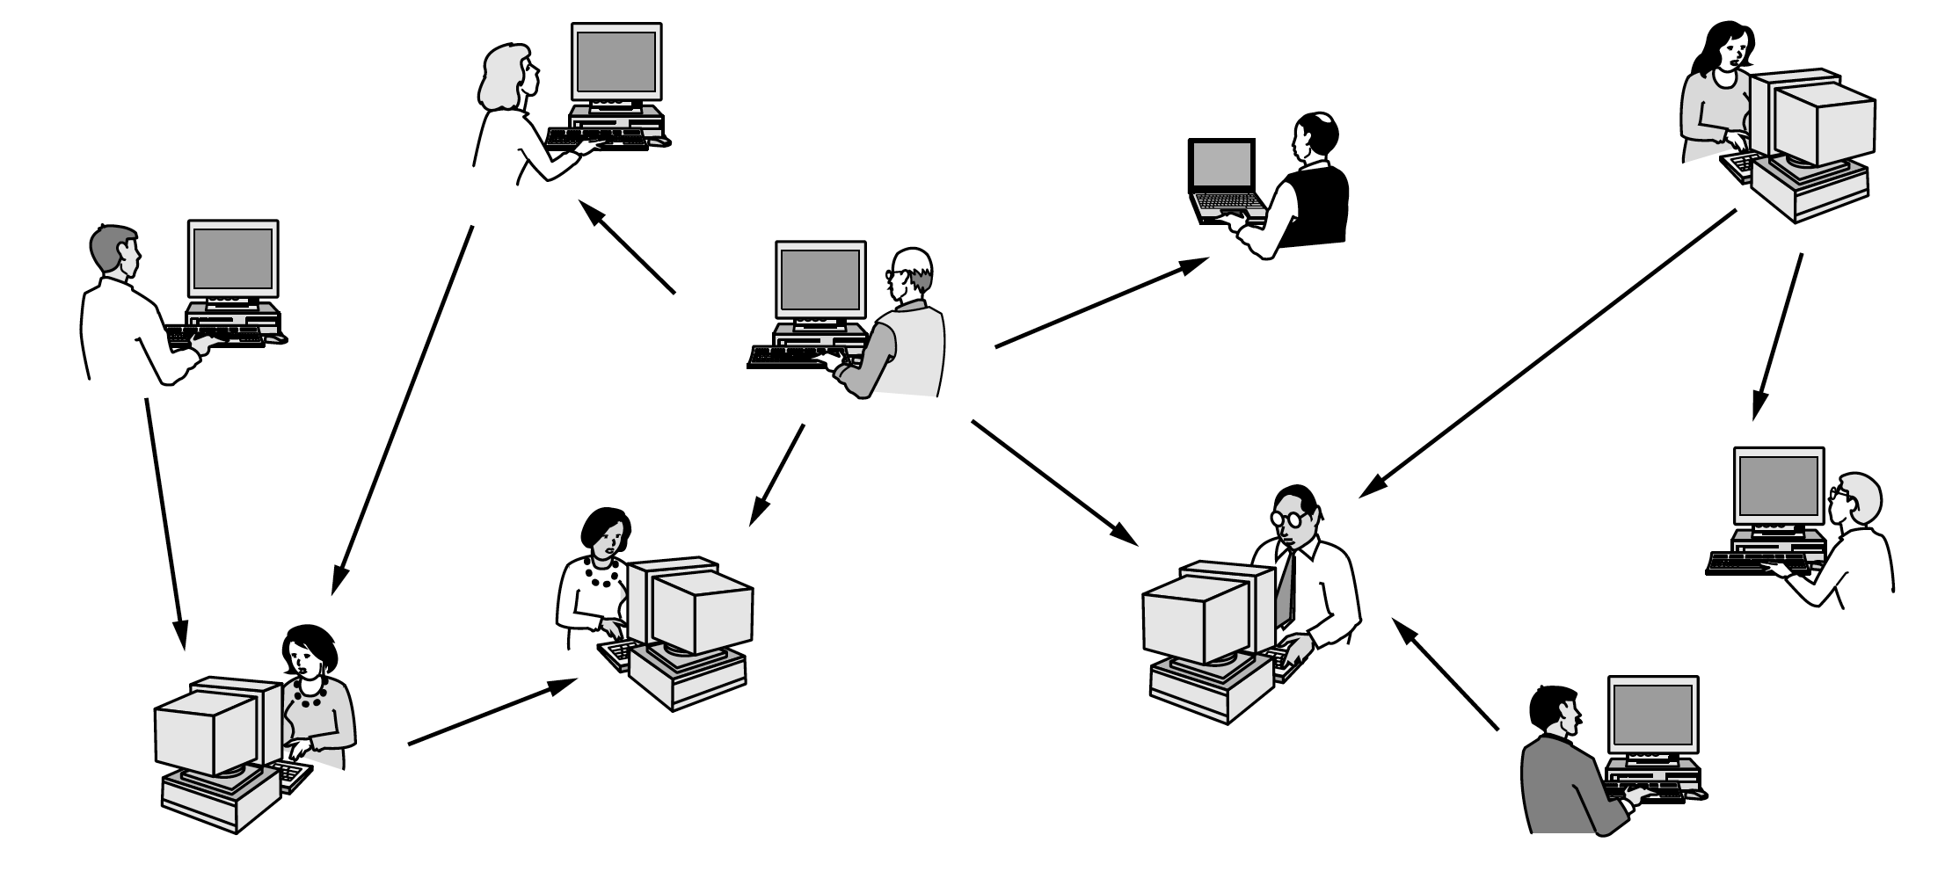
Home Application
Peer-to-peer model (BitTorrent (Cohen, 2003))

Slide 11
Home Application
Instant messaging
Twitted, Facebook, WhatsApp
Wikipedia – a group of people creating contents…
E-commerce…

Slide 12
Others
Mobile Users
Connectivity
Mobile hotspot
Texting, sms
GPS
M-commerce
NFC (Near Field Communication)
Social Issues

Slide 13
Transmission Technology
Two types of transmission technology that are in widespread use:
broadcast links &
point-to-point links.
Point-to-point links connect individual pairs of machines.
To go from the source to the destination on a network made up of point-to-point links, short messages, called packets in certain contexts, may have to first visit one or more intermediate machines.
Often multiple routes, of different lengths, are possible, so finding good ones is important in point-to-point networks.
Point-to-point transmission with exactly one sender and exactly one receiver is sometimes called unicasting.

Slide 14
Network Hardware
Point to point
Broadcast
On a broadcast network, the communication channel is shared by all the machines on the network; packets sent by any machine are received by all the others.
An address field within each packet specifies the intended recipient.
Upon receiving a packet, a machine checks the address field. If the packet is intended for the receiving machine, that machine processes the packet; if the packet is intended for some other machine, it is just ignored

Slide 15
Network Hardware
This mode of operation is called broadcasting.
Some broadcast systems also support transmission to a subset of the machines, which known as multicasting.

Slide 16
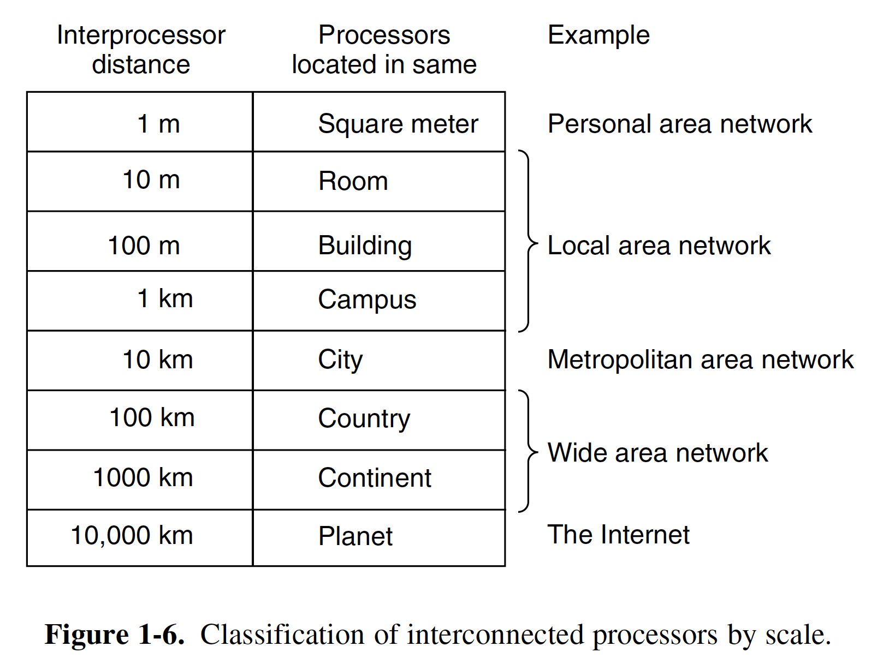
Network Hardware
An alternative criterion for classifying networks is by scale.

Slide 17
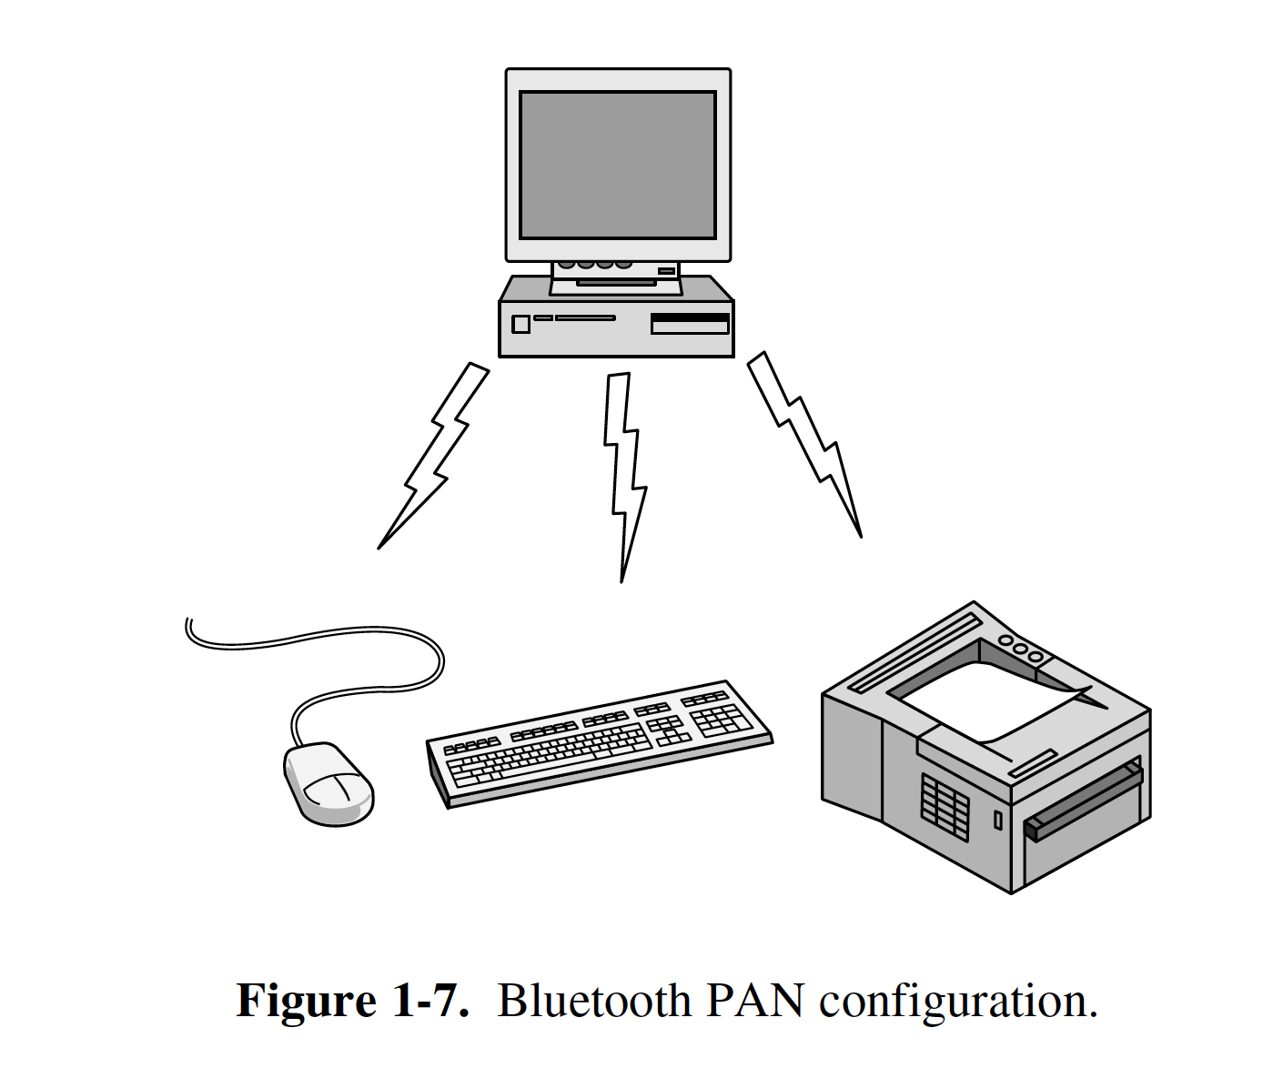
Personal Area Networks
Personal Area Networks
bluetooth

Slide 18
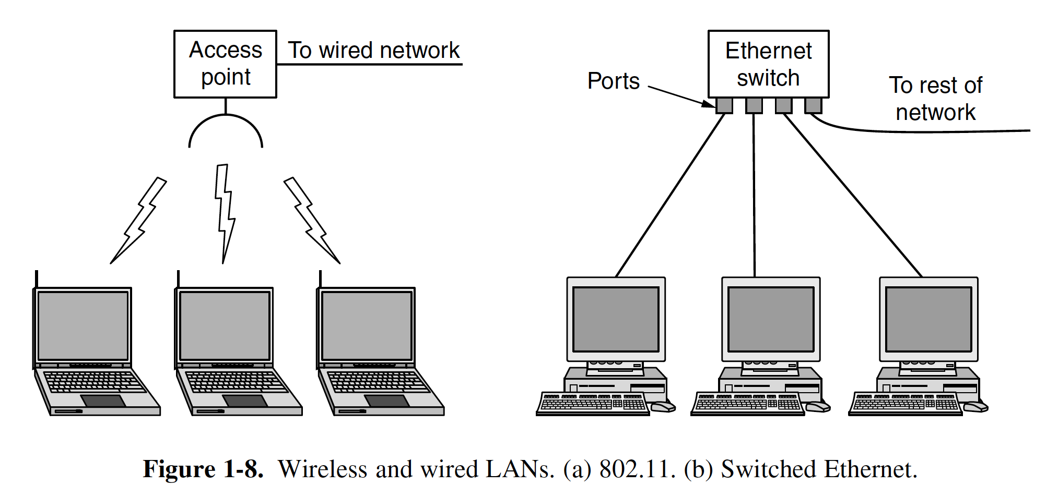
Local Area Networks

Slide 19
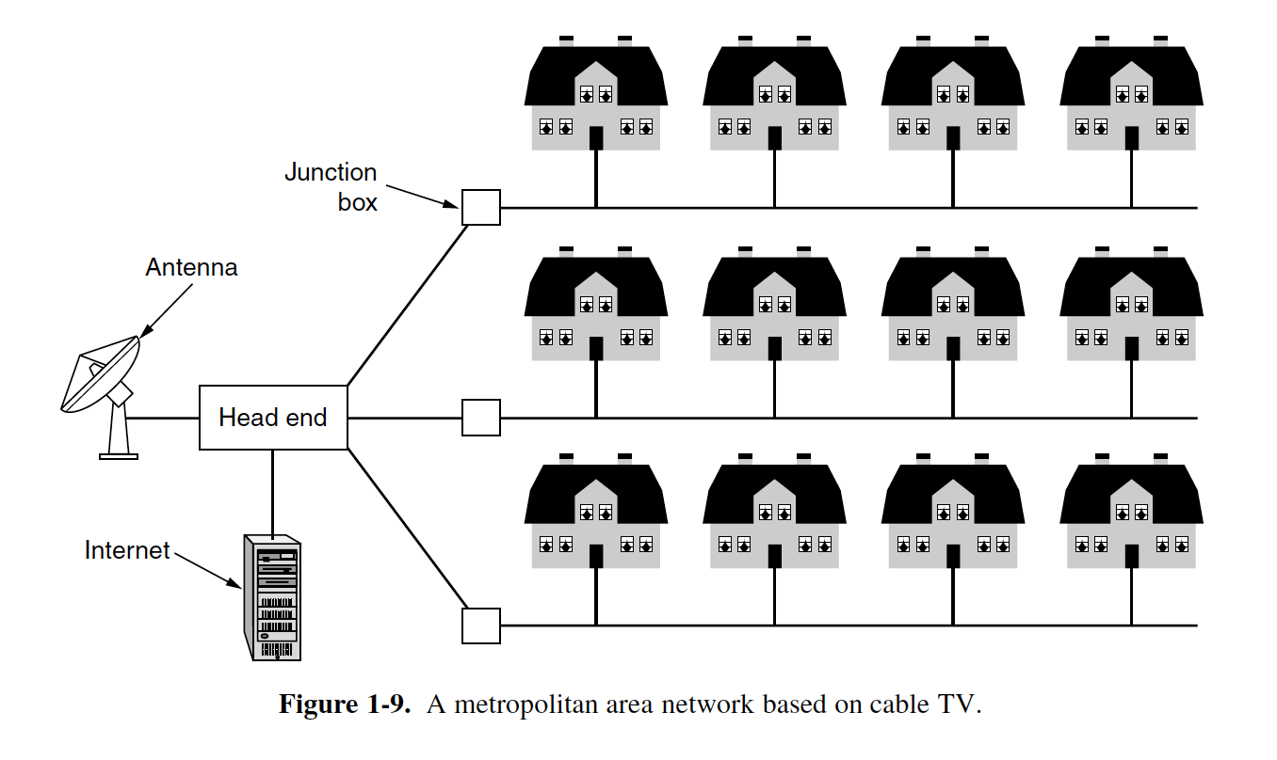
Metropolitan Area Networks
MAN
Cable headed
WiMAX

Slide 20
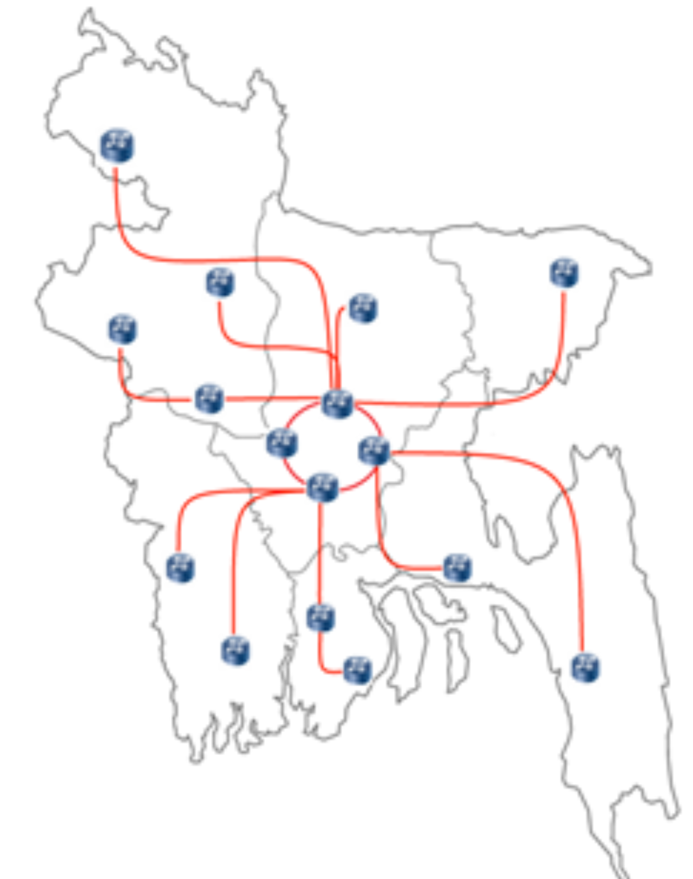
Wide Area Networks
BdRen
WAN

Slide 21
Internetworks
https://www.submarinecablemap.com/

Slide 22
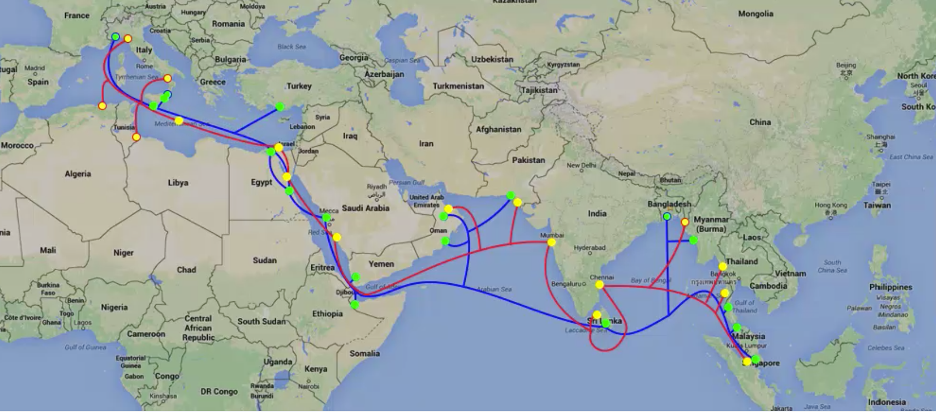
Internetworks

Slide 23
Network Software
The first computer networks were designed with the hardware as the main concern and the software as an afterthought.
This strategy no longer works.
To reduce their design complexity, most networks are organized as a stack of layers or levels, each one built upon the one below it.

Slide 24
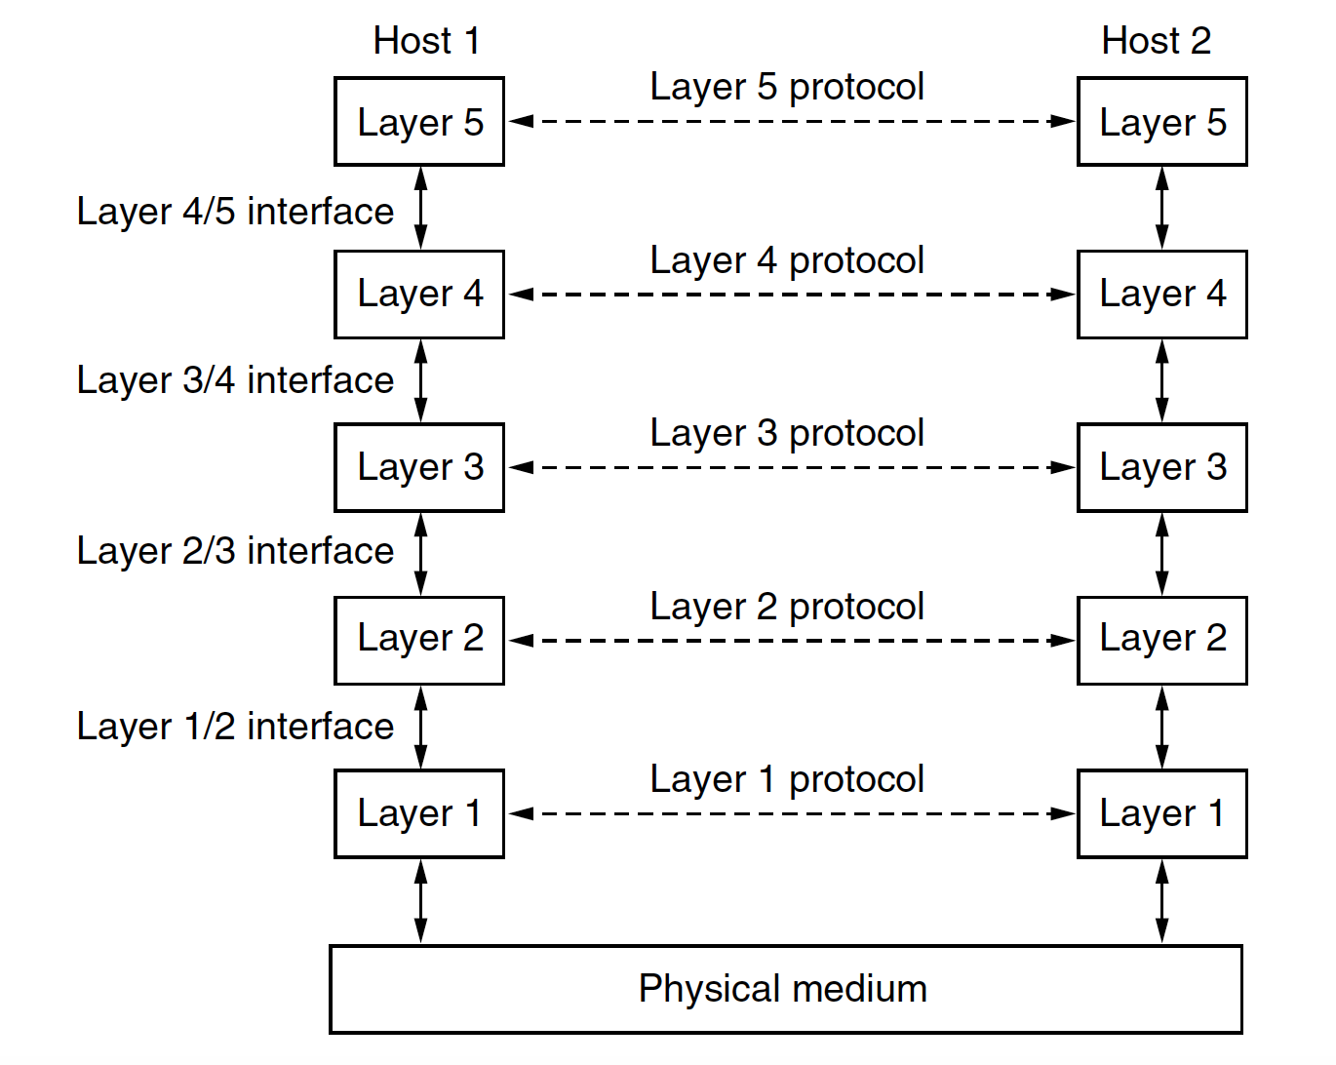
Network Software
A protocol is an agreement between the communicating parties on how communication is to proceed.
Peer – both host
A set of layers and protocols is called a network architecture.
A list of the protocols used by a certain system, one protocol per layer, is called a protocol stack.

Slide 25
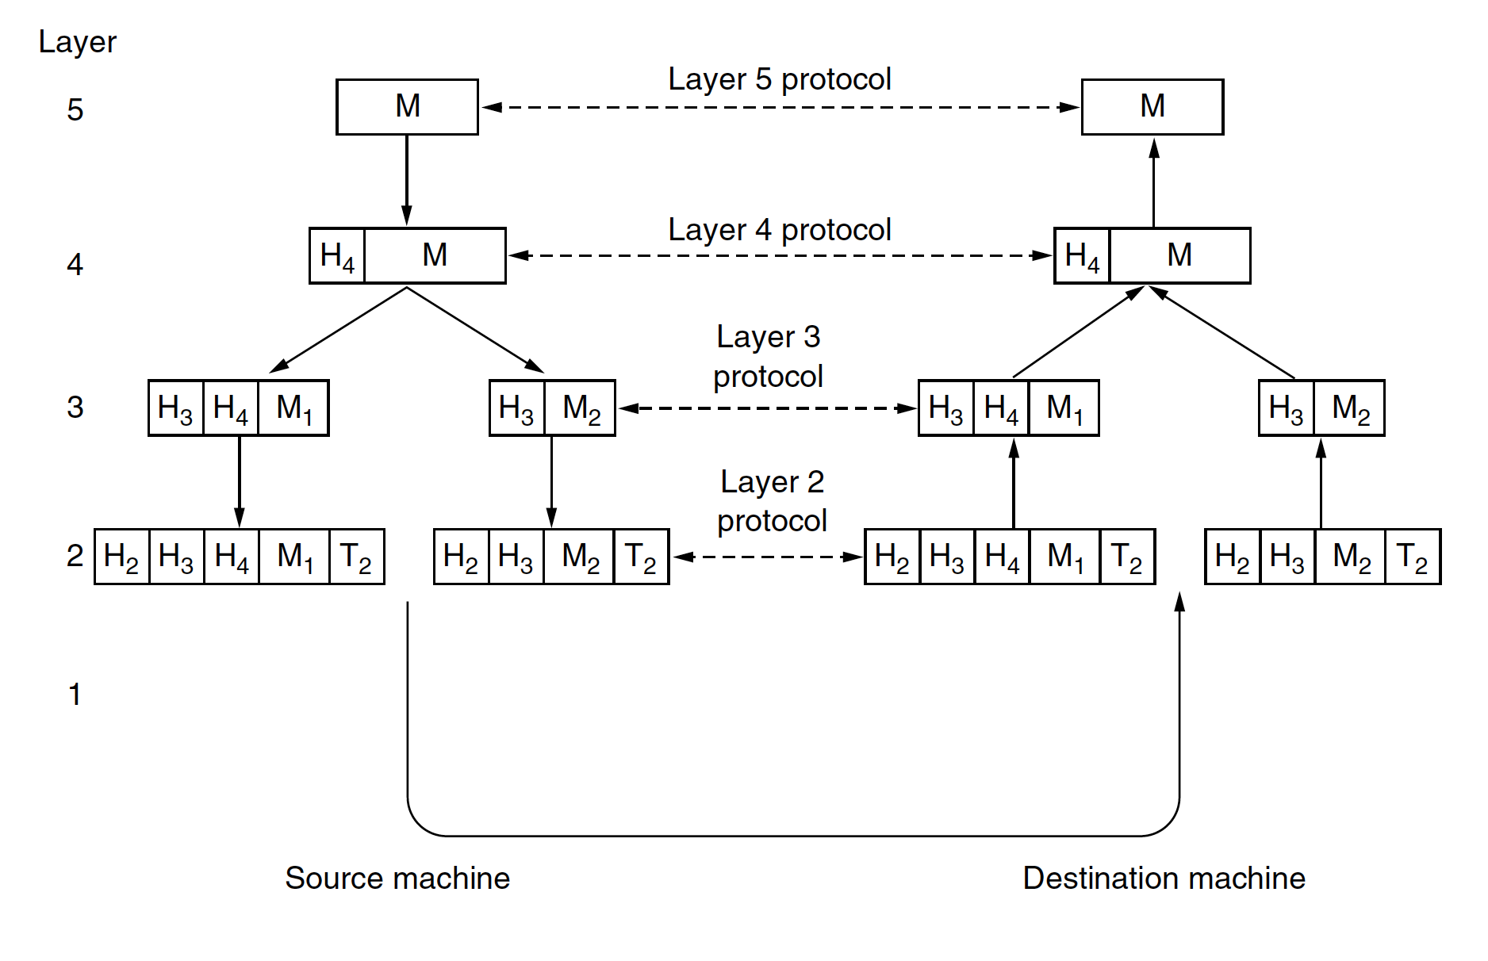
Network Software

Slide 26
Design Issues for the Layers
Reliability
uses codes for error detection.
error correction
They are used at low layers,
Routing
Finding a working path through a network
addressing or naming,
internetworking.

Slide 27
Design Issues for the Layers
Resource allocation.
Who will get priority
flow control.
Quality of service
Confidentiality
authentication
Integrity

